Slide 1


Hii,
Iam Siddhika
Welcome to Power BI Series
Part -72

Slide 2



I’m very excited to dive into this with you all!
Are you ready to enhance your data visualization skills?
We focus only on the most used and important Visuals
Today Content
VISUALIZING DATA
SLICERS
DIFFERENCE BETWEEN SLICER AND FILTER

Slide 3

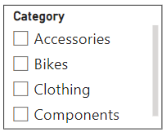

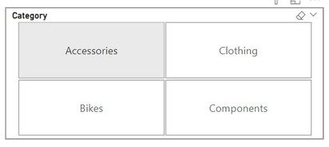

SLICERS
go and try all styles of slicer
A slicer is a visual filter in Power BI that allows users to segment and filter data dynamically on a report or dashboard.
Slicers can take many formats including lists, dropdowns, tiles.
Purpose:
To quickly and easily filter data in a report.
To provide an interactive way for users to explore data.

Slide 4

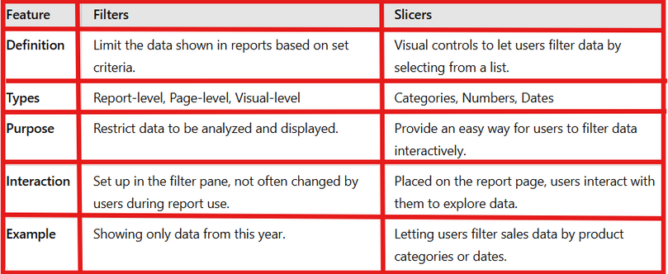

DIFFERENCE BETWEEN SLICER AND FILTER
Slicer: A visual tool that allows users to filter data on a report page. It provides an interactive way to select values and see changes in other visuals based on those selections.
Filter: A broader term that can refer to any method of restricting data in Power BI, including filters applied at the visual, page, or report level. Filters can be set up in the visualizations pane and don't require user interaction.
got it

Slide 5


Thank you for joining me today to learn about Part -72 of Power BI!
Remember, Effective data visualization is crucial for turning data into meaningful insights and compelling narratives with Power BI.
Stay tuned for more insights and tips on Power BI in our next Series.
Follow
Siddhika Shah

